Slide 1
Psychosocial Problems

Slide 2
General Problems in Adolescence
Most adolescents report positive outcomes and psychosocial development.
Most psychosocial problems:
  Are often transitory experimentation
  Don’t all begin in adolescence
  Do not persist into adulthood
  Are not “caused” by adolescence.

Slide 3
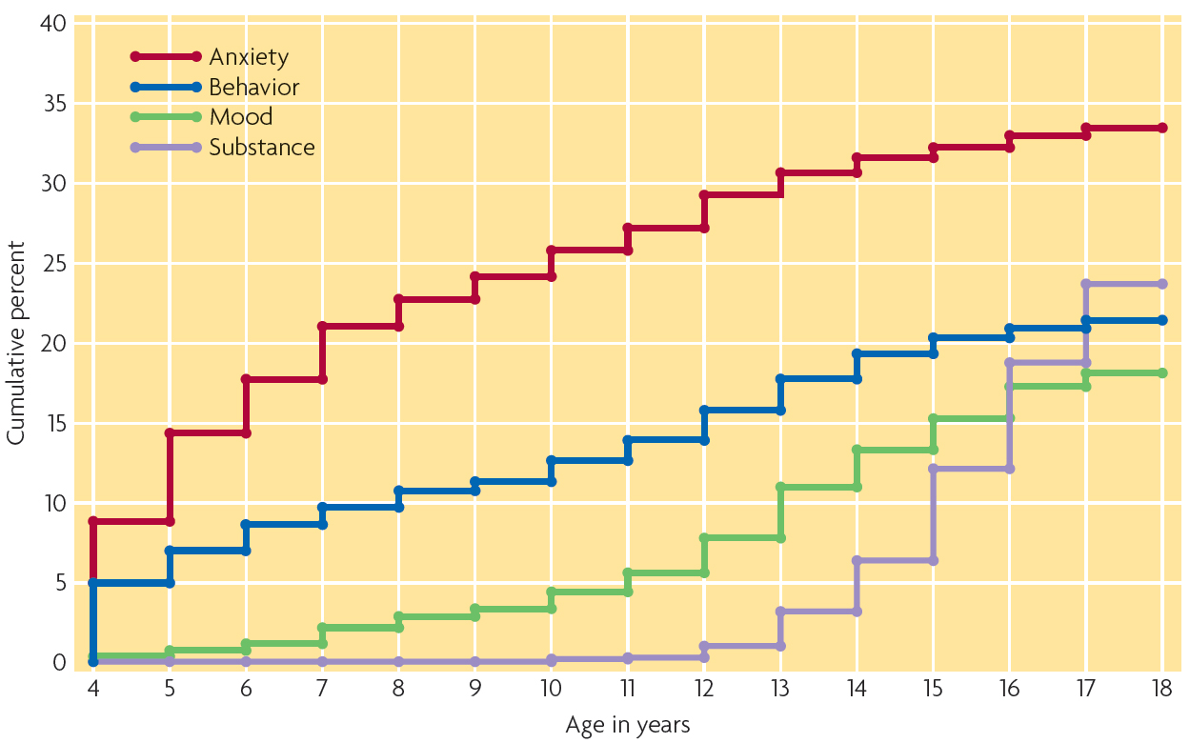
Problems in Adolescence
Figure 1: Anxiety disorders and behavioral disorders typically begin during childhood, whereas mood disorders and substance abuse first appear during adolescence.
Notes:
Figure 1

Slide 4
Psychosocial Problems
Three broad categories of problems:
  Substance abuse: use of drugs (illegal and legal)
  Internalizing disorders: problems turned inward (emotional or cognitive distress)
  Externalizing disorders: problems turned outward (behavioral problems).
Substance abuse in particular is often co-morbid (or co-occurring) with both internalizing and externalizing disorders.

Slide 5
Problem Behavior Syndrome
Many adolescents with behavior problems experience multiple problem behaviors.
High levels of comorbidity make it difficult to differentiate between internalizing and externalizing
Problem Behavior Syndrome
  Cause of externalizing behaviors is unconventionality in the adolescents personality and social environment.
    Tolerance of deviance
    Not connected to school/religious institutions
    Highly liberal views

Slide 6

Problem Behavior Syndrome
Problem clusters
  One problem may lead to another problem.
  Cascading effect
Figure 2: One explanation for comorbidity is that problems in one domain can create problems in another.

Slide 7
Problem Behavior
Social Control Theory
  Individuals without strong bonds to social institutions are more likely to deviate from the norm and behave in unconventional ways.
  Problems stem not from within the individual but from underlying weaknesses in the individuals attachment to society.
  Helpful in understanding problem behavior in poor, inner city minority youths.
  Stresses the importance of the social context.

Slide 8
Comorbidity of Internalizing Problems
Share a subjective state of distress.
Negative emotionality
  Presumed cause of internalizing disorders, characterized by a subjective state of distress.
  Adolescents high in negative emotionality are more likely to suffer from depression, anxiety, and other symptoms of distress.

Slide 9
Substance Use and Abuse
Society sends mixed messages to youth about drugs and alcohol.
  Reflects the inconsistent way that we view these substances as a society.
  Some drugs are okay in some circumstances and not okay in others.
  https://www.youtube.com/watch?v=yJwd-4xgdgE

Slide 10
Prevalence of Substance Use and Abuse
Alcohol, tobacco, and marijuana are by far the most commonly used and abused substances.
  High school seniors: 66% have tried alcohol, 44% have smoked marijuana, and 34% have smoked cigarettes.
  Only about 8% have used an illicit drug (other than marijuana) in the last month.

Slide 11
Prevalence of Substance Use and Abuse
Only a small percentage of adolescents use any substance daily.
  10% of high school seniors smoke cigarettes daily; 2% use alcohol daily; 7% use marijuana daily.
Binge drinking: 5 or more drinks in a row on one occasion.
  20% of seniors, 13% of 10th graders and 4% of 8th graders

Slide 12
Trends Across Time
Research suggests that drug and substance use hasn’t gotten better or worse.
  Trends in marijuana use have not changed much.
  Drinking has declined slowly or not at all.
  Since 1990s, smoking has decreased dramatically.
Early substance use (prior to age 15) is a risk factor for development of addiction.

Slide 13
Ethnic Differences in Substance Use
Immigrant paradox
    Foreign-born and less Americanized minority youth are less likely to use drugs, alcohol, and tobacco than their American-born counterparts.
The rate of drug use among immigrant adolescents is half the rate of use among adolescents from the same ethnic group who were born in the United States.

Slide 14
Progression of Use
Substance use does tend to follow a progression, from experimentation with alcohol, to marijuana use, to more illicit drugs.
However, little evidence to suggest that marijuana is a “stepping stone” to hard drug use (depends on the frequency of use).
  Gateway drugs
Developmental trajectory of substance use
  Increases during adolescence, peaks in early 20s, declines.

Slide 15
Causes and Consequences of Substance Use and Abuse
Important to stress difference between occasional experimentation and problematic use.
Experimenters and abstainers score better on measures of psychological adjustment.
Adolescents who use alcohol, tobacco, or other drugs frequently are usually exhibiting symptoms of prior psychological disturbance.
Major risk factors are:
  Personality – Anger, impulsivity, and inattentiveness
  Family – Distant, hostile, or conflicted relationships
  Socially – Friends who use and tolerate the use of drugs
  Contextual – Live in a context that makes drug use easy

Slide 16
Protective Factors
Major protective factors (factors that limit individual vulnerability to harm) are:
  positive mental health.
  high academic achievement.
  engagement in school.
  close family relationships.
  involvement in religious activities.

Slide 17
Drugs and the Adolescent Brain
Adolescent brain is still malleable (changing).
Potential for addiction is greater during adolescence.
Certain drugs affect receptors for dopamine, one of the neurotransmitters that influence our experience of pleasure.
The molecules of addictive drugs are so similar to dopamine molecules that dopamine receptors respond to them in the same was as they do in the presence of natural dopamine.
Frequent drug use interferes with the normal maturation of the brain’s dopamine system.
  Could make it necessary to use drugs to experience normal amounts of pleasure.

Slide 18
Prevention and Treatment
Efforts to prevent abuse target:
  the supply of drugs (most government attention and money focused here).
  the environment in which teens are exposed to drugs.
  characteristics of the potential drug user.
Experts believe it is more realistic to focus prevention efforts on adolescents’ motivation and environment.
Most supported programs to reduce substance use involves some sort of social competence training with a community-wide intervention (aimed at the adolescents, peers, parents, and teachers).

Slide 19
Externalizing Problems

Slide 20
Externalizing Problems
Conduct Disorder
  A repetitive and persistent pattern of antisocial behavior that results in problems at school or work, or in relationships with others.
Oppositional-Defiant Disorder
  A disorder of childhood and adolescence characterized by excessive anger, spite, and stubbornness.
Antisocial Personality Disorder
  A disorder of adulthood characterized by antisocial behavior and persistent disregard for the rules of society and the rights of others.
  Individuals with CD who continue to display antisocial characteristics.

Slide 21
Externalizing Behavior
Psychopaths
  Individuals who are not only antisocial but also manipulative, superficially charming, impulsive, and indifferent to the feelings of others.
  Callous-unemotional traits (CU)
    A cluster of traits characteristic of psychopathic individuals, which includes a lack of empathy and indifference toward the feelings of others.
    Often used to distinguish between adolescents with CD
Antisocial Personality Disorder and Psychopaths imply a deep seated personality problem and so these are typically not applied to individuals under the age of 18.

Slide 22
Aggression
Another type of externalizing behavior, behavior intended to harm another.
  Examples:
    physical fighting
    relational aggression
    intimidation
Can be instrumental (planned) or reactive (unplanned).

Slide 23
Juvenile Offending
“Juvenile offending” is legal term.
Includes delinquency and criminal behavior, as well as status offenses.
Violence (e.g., assault, rape, robbery, and murder) and property crimes (e.g., burglary, theft arson)
A large amount of juvenile offenders are aggressive and/or have CD, but whether they are juvenile defenders depends on whether they have broken the law.
  Increases in frequency between the preadolescent and adolescent years.
  Peaks during high school then declines in young adulthood (the age-crime curve).

Slide 24
Juvenile Offending
Antisocial behavior takes the form of:
  authority conflicts (running away).
  covert antisocial behavior (stealing).
  overt antisocial behavior (attacking someone with a weapon).
Not all bullies end up as violent criminals, but reverse is almost always true.
Majority of juvenile offenders have some sort of aggressive, oppositional past.

Slide 25
Gender Differences in Juvenile Offending
Decline in the gender gap in serious offending over the past several decades (4:1)
    Not clear whether this change is mainly due to changes in actual offending or changes in arrest practices among girls.
    Also possible that boys offending behavior may have declined while girls remained stable.

Slide 26
Causes of Antisocial Behavior
Two types of offenders:
Adolescent-Limited offenders
Life-course persistent offenders:
  demonstrate antisocial behavior before adolescence.
  involved in delinquency during adolescence.
  Disorganized families, ineffective parenting.
  Self-regulation difficulties
  CU is related to low resting heart rate- biological tendency towards fearlessness.
  Hostile attribution bias
Best predictor of persistent antisocial behavior is NOT antisocial behavior during adolescence, but during childhood.

Slide 27

Life-Course Persistent Offenders
Figure 8: Adolescent violence is often the long-term consequence of a process that begins early in life.
Notes:
Figure 8

Slide 28
Adolescent Limited Offenders
Do not usually show signs of psychological problems or family pathology.
Still show more problems than teens who are not at all delinquent.
  More mental health, substance abuse, and financial problems.
Risk factors include:
  poor parenting (especially poor monitoring).
  affiliation with antisocial peers.

Slide 29
Prevention and Treatment
Different approaches depending on what type of anti-social behavior.
Chronic
  Prevent early family conflict
  Early academic programs
  Outcomes for early career criminals are not very good, although some evidence based programs exist.
Adolescent-limited
  Prognosis is much better.
  Teach youth to resist peer pressure, conflict resolution skills, parent training, consequences for delinquency.

Slide 30
Internalizing Problems

Slide 31
Internalizing Problems
Temporary changes or fluctuations in mood and self esteem are commonplace during adolescence. When this becomes persistent or prolonged it becomes disordered.
Depression is the most common psychological disturbance among adolescents.
  emotional, cognitive, motivational, and physical symptoms
  Continuum (depressed mood, depressive symptoms, depressive disorder)
Prevalence
  8% of American Teens between 13 and 18 meet DSM criteria.
Increase in depression during adolescence
  Increased stressors
  Increases in cognition (and introspection and rumination).

Slide 32
Sex Differences in Depression
Before puberty: more prevalent among boys
After puberty: more prevalent among girls.
  Many researchers attribute gender differences to social roles, sensitive to stress, tendencies to ruminate and sensitivity to others.

Slide 33
Anxiety
Anxiety is also a prevalent adolescent disorder.
Anxiety: feelings of worry, nervousness, unease
  Generalized Anxiety
  Phobias
  Social Anxiety
  Panic Disorder

Slide 34
Suicide and Non-Suicidal Self-Injury
10% of female and 5% of male high school students attempt suicide.
  1/3 of attempts are serious enough to warrant treatment.
Suicidal ideation: thinking about killing oneself
  Increases during adolescence, peaks at 15, and then declines.
Some adolescents commit acts of nonsuicidal self-injury (NSSI).
  Example: Deliberately burning or cutting oneself
  Nearly 25% of adolescents have done this at least once.

Slide 35
Suicide Risk Factors
Four established risk factors of suicide:
  Psychiatric problem (depression or substance use)
  Having a family history of suicide
  Experiencing extreme family conflict
  Intense stress
Suicide contagion
  Increased likelihood of suicide attempts is a friend or someone in the community has committed suicide.
  Important for media to stress help seeking and avoid portraying suicide as something “liberating”

Slide 36
Causes of Depression and Internalizing Disorders
Diathesis-stress model
  Depression occurs via an interaction between biological and environment.
  People with a predisposition towards internalizing problems are exposed to a chronic or acute stressor.
The Diathesis
  Biological in origin (neuroendocrine or genetically linked), or because of cognitive style.
The Stress
  Primarily from having a high-conflict and low-cohesion family, being unpopular, or reporting more chronic and acute stressors.

Slide 37
Treatment
Biological therapies (medication)
Psychotherapy
  Cognitive Behavior Therapy
  Understand the roots of their depression and change cognitions.
Family therapy.
  Changing patterns of family relationships

